Slide 1
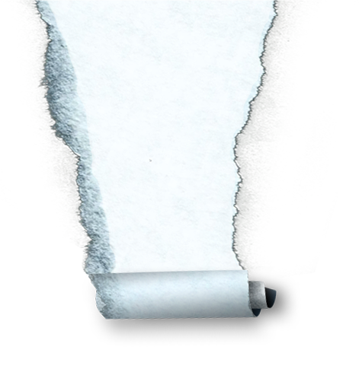


Algorithm Design and Analysis
算法设计与分析
软件学院 ·2023

Slide 2
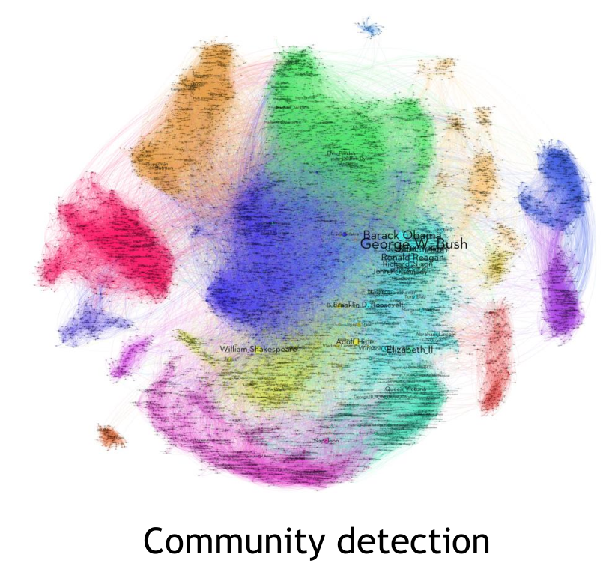
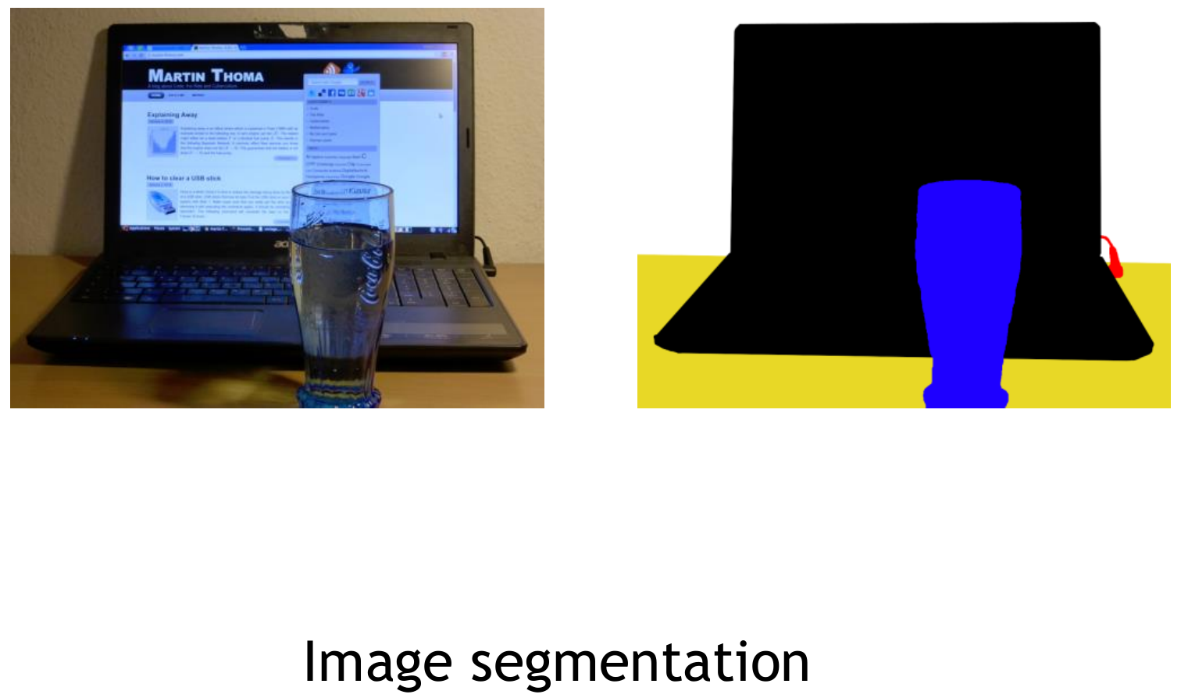
Flow network applications

Slide 3
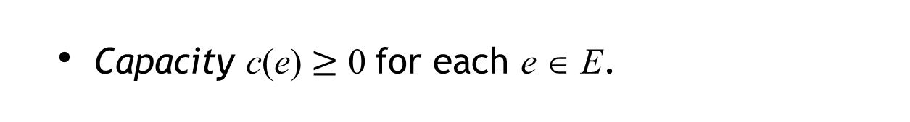
Flow network
A flow network is a tuple G = (V, E, s, t, c).
・Digraph (V, E) with source s ∈ V and sink t ∈ V.
・Capacity c(e) $≥$ 0 for each e ∈ E.
Intuition. Material flowing through a transportation network; material originates at source and is sent to sink.
capacity
9
10
4
15
15
10
s
5
8
10
t
15
4
6
15
10
16

Slide 4
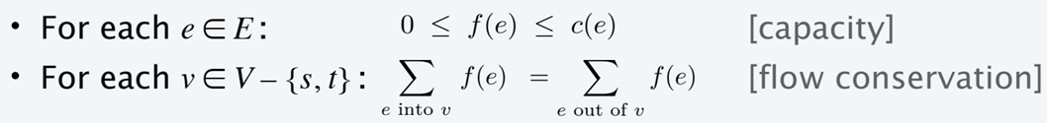



Maximum-flow problem
Def. A flow f is a function over E that satisfies:
flow
capacity
5 / 9
10 / 10
0 / 4
5 / 15
0 / 15
5 / 10
s
5 / 5
5 / 8
v
10 / 10
t
10 / 15
0 / 4
0 / 6
0 / 15
10 / 10
10 / 16

Slide 5
Maximum-flow problem
Def. A flow f is a function over E that satisfies:
for each v ≠ s, t, f ^{in} (v) = f ^{out} (v)
flow
capacity
inflow at v = 5 + 5 + 0 = 10 = f ^{in} (v)
outflow at v = 10 + 0 = 10 = f ^{out} (v)
e is saturated if f(e) = c(e)
5 / 9
10 / 10
0 / 4
5 / 15
0 / 15
5 / 10
s
v
5 / 5
5 / 8
v
10 / 10
t
10 / 15
0 / 4
0 / 6
0 / 15
10 / 10
10 / 16

Slide 6
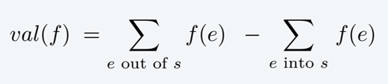
Maximum-flow problem
Def. A flow f is a function over E that satisfies:
Def. The value of a flow f is:
f ^{out} (s) - f ^{in} (s)
5 / 9
10 / 10
0 / 4
5 / 15
0 / 15
5 / 10
s
5 / 5
5 / 8
10 / 10
t
10 / 15
0 / 4
0 / 6
0 / 15
10 / 10
value = 5 + 10 + 10 = 25
10 / 16

Slide 7
Maximum-flow problem
Def. A flow f is a function over E that satisfies:
Def. The value of a flow f is:
Max-flow problem. Find a flow of maximum value.
8 / 9
10 / 10
0 / 4
2 / 15
0 / 15
8 / 10
s
5 / 5
8 / 8
10 / 10
t
13 / 15
0 / 4
3 / 6
0 / 15
10 / 10
value = 10 + 5 + 13 = 28
13 / 16

Slide 8
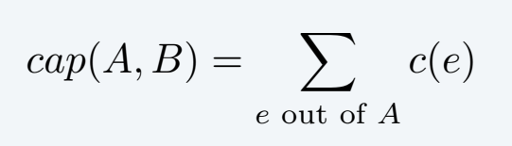
Minimum-cut problem
Def. A cut is a partition (A, B) of the nodes in V with s ∈ A and t ∈ B.
s ∉ B, and t ∉ A
Def. Its capacity is the sum of the capacities of the edges from A to B:
s
t

Slide 9
Minimum-cut problem
Def. A cut is a partition (A, B) of the nodes in V with s ∈ A and t ∈ B.
s ∉ B, and t ∉ A
Def. Its capacity is the sum of the capacities of the edges from A to B:
4
10
s
8
t
don’t include edges from B to A
6
capacity = 10 + 8 + 16 = 34
16

Slide 10
Minimum-cut problem
Def. A cut is a partition (A, B) of the nodes in V with s ∈ A and t ∈ B.
s ∉ B, and t ∉ A
Def. Its capacity is the sum of the capacities of the edges from A to B:
10
s
5
t
15
capacity = 10 + 5 + 15 = 30

Slide 11
Minimum-cut problem
Def. A cut is a partition (A, B) of the nodes in V with s ∈ A and t ∈ B.
s ∉ B, and t ∉ A
Def. Its capacity is the sum of the capacities of the edges from A to B:
Min-cut problem. Find a cut of minimum capacity.
10
s
8
t
10
capacity = 10 + 8 + 10 = 28

Slide 12

Network flow: quiz
Which is the capacity of the given st-cut?
A. 11 (20 + 25 − 8 − 11 − 9 − 6)
B. 34 (8 + 11 + 9 + 6)
C. 45 (20 + 25)
D. 79 (20 + 25 + 8 + 11 + 9 + 6)
capacity
s
20
8
10
6
12
8
11
9
6
8
1
16
25
t

Slide 13


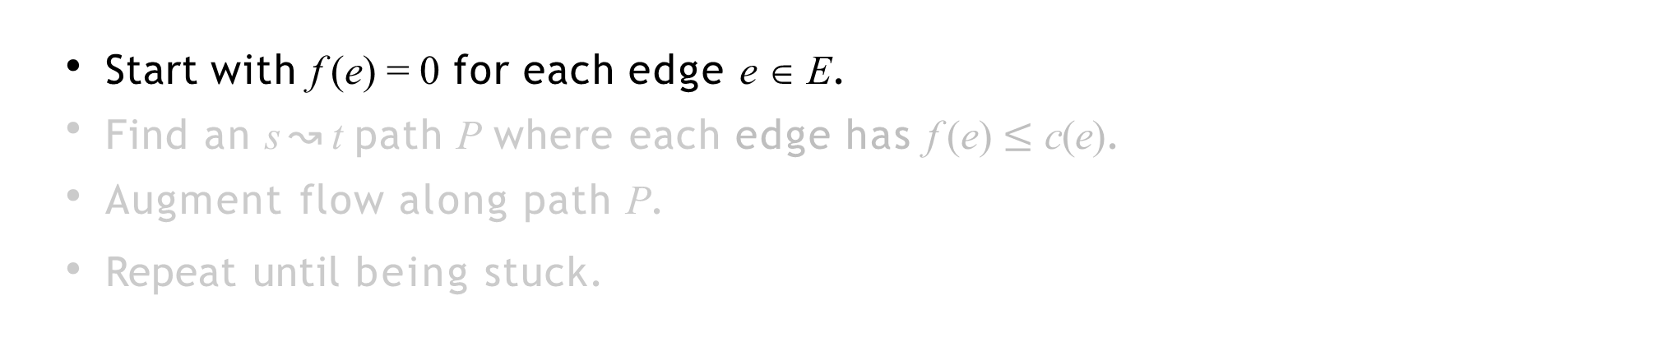
Toward a max-flow algorithm
Let’s first see a Greedy algorithm, before introducing Ford-Fulkerson algorithm.
・Start with f (e) = 0 for each edge e ∈ E.
・Find an s ↝ t path P where each edge has f (e) $≤$ c(e).
・Augment flow along path P.
・Repeat until being stuck.
flow value = 0
flow network G and flow f
0 / 4
0 / 10
0 / 2
0 / 8
0 / 6
0 / 10
s
0 / 10
0 / 9
0 / 10
t

Slide 14
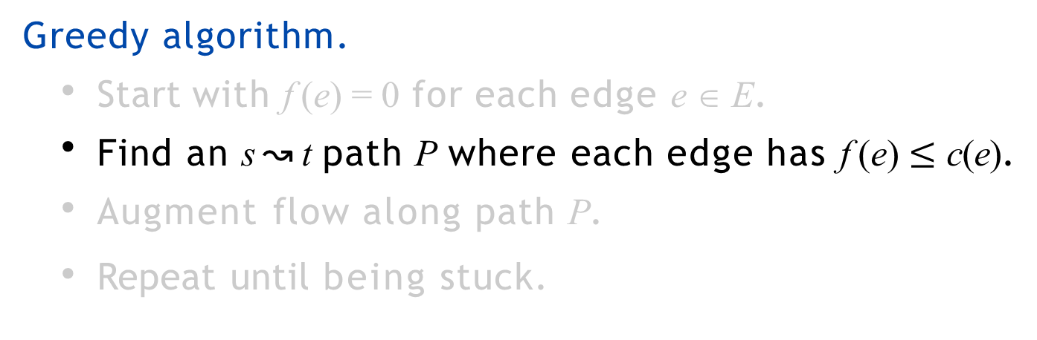
Toward a max-flow algorithm
Greedy algorithm.
・Start with f (e) = 0 for each edge e ∈ E.
・Find an s ↝ t path P where each edge has f (e) $≤$ c(e).
・Augment flow along path P.
・Repeat until being stuck.
flow network G and flow f
0 / 4
0 / 10
0 / 2
0 / 8
0 / 6
0 / 10
s
0 / 10
0 / 9
0 / 10
t

Slide 15
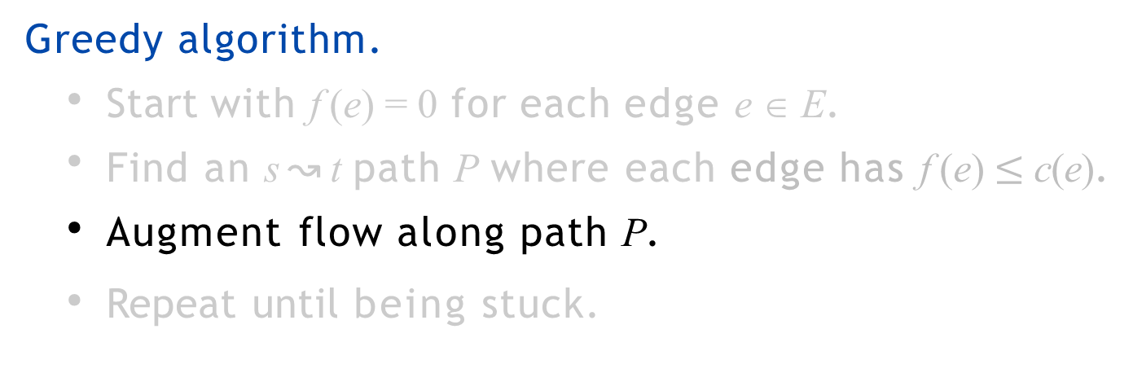
Toward a max-flow algorithm
Greedy algorithm.
・Start with f (e) = 0 for each edge e ∈ E.
・Find an s ↝ t path P where each edge has f (e)$≤$ c(e).
・Augment flow along path P.
・Repeat until being stuck.
flow network G and flow f
0 / 4
0 / 10
0 / 2
0 / 8
0 / 6
0 / 10
s
0 / 10
0 / 9
0 / 10
t

Slide 16
Toward a max-flow algorithm
Greedy algorithm.
・Start with f (e) = 0 for each edge e ∈ E.
・Find an s ↝ t path P where each edge has f (e)$≤$ c(e).
・Augment flow along path P.
・Repeat until being stuck.
flow value = 8
flow network G and flow f
0 / 4
8
8
0 / 10
0 / 2
0 / 8
0 / 6
0 / 10
s
8
t
0 / 10
0 / 9
0 / 10

Slide 17
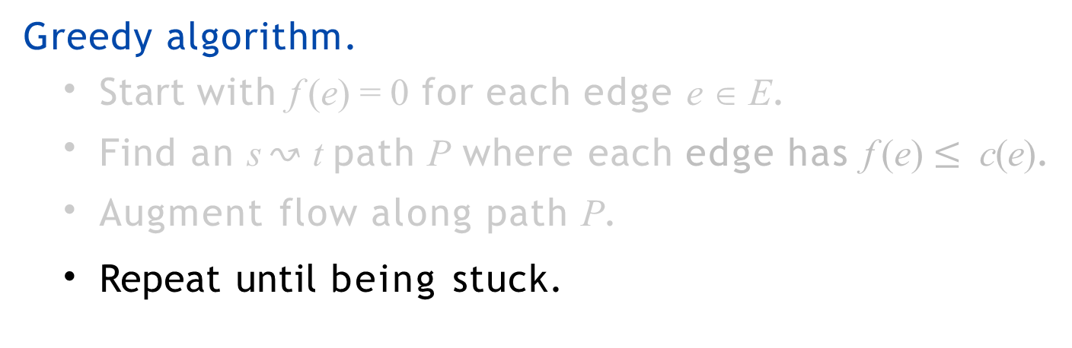
Toward a max-flow algorithm
Greedy algorithm.
・Start with f (e) = 0 for each edge e ∈ E.
・Find an s ↝ t path P where each edge has f (e) $≤$ c(e).
・Augment flow along path P.
・Repeat until being stuck.
flow network G and flow f
0 / 4
8 / 10
0 / 2
8 / 8
0 / 6
0 / 10
s
0 / 10
0 / 9
8 / 10
t

Slide 18

Toward a max-flow algorithm
Greedy algorithm.
・Start with f (e) = 0 for each edge e ∈ E.
・Find an s ↝ t path P where each edge has f (e) $≤$ c(e).
・Augment flow along path P.
・Repeat until being stuck.
flow value = 10
flow network G and flow f
0 / 4
10
8 / 10
2
0 / 2
8 / 8
0 / 6
0 / 10
s
2
10
t
0 / 10
0 / 9
8 / 10

Slide 19

Toward a max-flow algorithm
Greedy algorithm.
・Start with f (e) = 0 for each edge e ∈ E.
・Find an s ↝ t path P where each edge has f (e) $≤$ c(e). ・Augment flow along path P.
・Repeat until being stuck.
flow network G and flow f
0 / 4
10 / 10
2 / 2
8 / 8
0 / 6
0 / 10
s
0 / 10
2 / 9
10 / 10
t

Slide 20
Toward a max-flow algorithm
Greedy algorithm.
・Start with f (e) = 0 for each edge e ∈ E.
・Find an s ↝ t path P where each edge has f (e) $≤$ c(e). ・Augment flow along path P.
・Repeat until being stuck.
flow network G and flow f
0 / 4
6
10 / 10
2 / 2
8 / 8
6
0 / 6
0 / 10
s
6
8
t
0 / 10
2 / 9
10 / 10

Slide 21
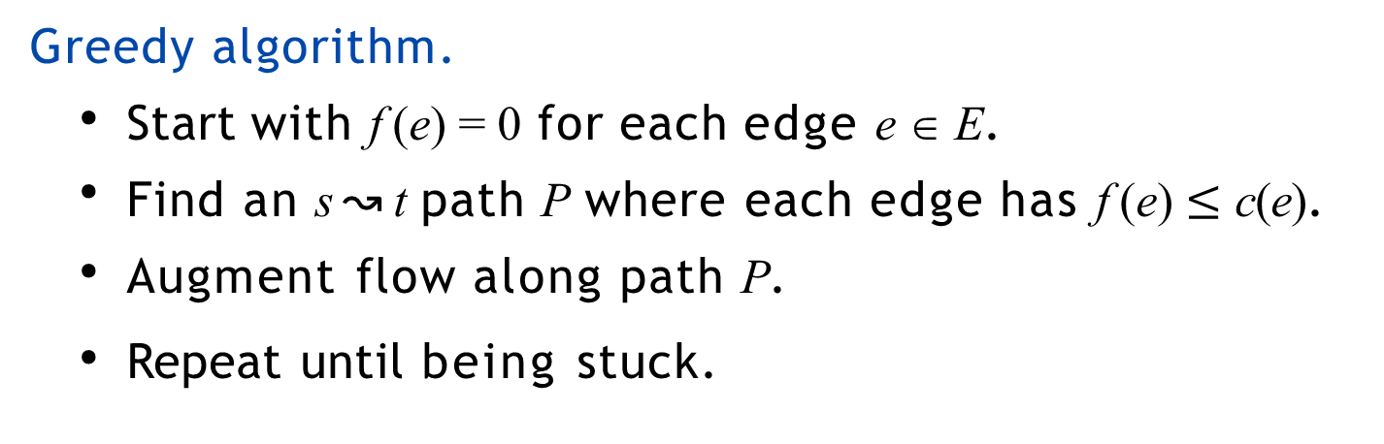
Toward a max-flow algorithm
Greedy algorithm.
・Start with f (e) = 0 for each edge e ∈ E.
・Find an s ↝ t path P where each edge has f (e) $≤$ c(e). ・Augment flow along path P.
・Repeat until being stuck.
flow value = 16
flow network G and flow f
0 / 4
Try other paths？
10 / 10
2 / 2
8 / 8
6 / 6
6 / 10
s
6 / 10
8 / 9
10 / 10
t

Slide 22

Toward a max-flow algorithm
Greedy algorithm.
・Start with f (e) = 0 for each edge e ∈ E.
・Find an s ↝ t path P where each edge has f (e) $≤$ c(e). ・Augment flow along path P.
・Repeat until being stuck.
but max flow value = 19 !
flow network G and flow f
3 / 4
10 / 10
0 / 2
7 / 8
6 / 6
9 / 10
s
9 / 10
9 / 9
10 / 10
t

Slide 23
Why fails
Q: Why does the greedy algorithm fail?
A: Once the greedy algorithm increases flow on an edge, it never decreases it.
Solution. Need some mechanism to “undo” a bad decision.

Slide 24

Residual network
Original edge. e = (u, v) ∈ E.
・Flow f (e).
original flow network G
・Capacity c(e).
u
6 /17
v
flow
capacity
Forward edge e = (u, v)
  e ∈ E and e ∈ E_{f}
  c_{f} (e) = c(e) – f (e)
residual network Gf
residual capacity
Backward edge e^{reverse} = (v, u)
  e^{reverse} ∉ E and e^{reverse} ∈ E_{f}
  c_{f} (e^{reverse}) = f (e)
  “undo” flow sent
u
11
v
6
forward edge
backward edge
Residual network. G_{f} = (V, E_{f} , s, t, c_{f} ).
・E = {e : f (e) < c(e)} {e^{reverse} : f (e) > 0}.
f

Slide 25



Residual network
network G and flow f
0 / 4
8/ 10
0/ 2
8/ 8
0 / 6
0 / 10
s
0 / 10
0 / 9
8 / 10
t
residual network Gf
4
8
2
6
10
8
2
s
10
9
2
8
t

Slide 26


Augmenting path
Def. An augmenting path is a simple s↝t path in the residual network G_{f} .
0 / 4
network G and flow f
10 / 10
2 / 2
8 / 8
6 / 6
6 / 10
s
6 / 10
8 / 9
10 / 10
t
10 + 6 = 16
4
residual network Gf
6
2
8
6
4
10
s
4
6
1
10
t
8

Slide 27
Augmenting path
Def. An augmenting path is a simple s↝t path in the residual network G_{f} .
Def. The bottleneck capacity of an augmenting path P is the minimum residual capacity of any edge in P.
residual network Gf
4
bottleneck capacity
6
2
8
6
4
10
s
4
6
1
10
t
8

Slide 28
Augmenting path
Def. An augmenting path is a simple s↝t path in the residual network G_{f} .
Def. The bottleneck capacity of an augmenting path P is the minimum residual capacity of any edge in P.
Key property. Let f be a flow and let P be an augmenting path in G_{f} . Then, after calling f ' ← AUGMENT( f, c, P), the resulting f ' is a flow and val( f ') = val( f ) + bottleneck(Gf, P).
AUGMENT( f, c, P)
δ ← bottleneck capacity of augmenting path P. FOREACH edge e ∈ P :
IF (e ∈ E) f (e) ← f (e) + δ.
ELSEIF RETURN f.
(e ∉ E ˄ e ∈ E_{f}) f (e) ← f (e) − δ.

Slide 29
Augmenting path
network G and flow f
0 / 4
2
8
10 / 10
0 2 / 2
8 / 8
6 / 6
6 / 10
s
8
t
16 + 2 = 18
6 / 10
8 / 9
10 / 10
10 + 6 = 16
residual network Gf
4
bottleneck capacity
6
2
8
6
4
10
s
4
6
1
10
t
8

Slide 30
Augmenting path
Def. An augmenting path is a simple s↝t path in the residual network G_{f} .
Def. The bottleneck capacity of an augmenting path P is the minimum residual capacity of any edge in P.
Key property. Let f be a flow and let P be an augmenting path in G_{f} . Then, after calling f ' ← AUGMENT( f, c, P), the resulting f ' is a flow and val( f ') = val( f ) + bottleneck(Gf, P).
This is easy to see. f ' respects the capacity constraints since we never increased the flow beyond the residual capacity of any arc. Flow conservation constraints are still satisfied since flow is augmented along a path from s to t, and for any node other than s or t along the path, the flow entering the node, and the flow leaving the node both increase by δ. Finally, the s-t flow increases by δ since the net flow out of s increases by δ.
AUGMENT( f, c, P)
δ ← bottleneck capacity of augmenting path P. FOREACH edge e ∈ P :
IF (e ∈ E) f (e) ← f (e) + δ.
ELSEIF RETURN f.
(e ∉ E ˄ e ∈ E_{f}) f (e) ← f (e) − δ.

Slide 31
Network flow: quiz
Which is the augmenting path of highest bottleneck capacity?
A → F → G → H
A → B → C → D → H
A → F → B → G → H
A → F → B → G → C → D → H
residual capacity
5
A
9
B
8
C
6
D
source
5
7
8
7
4 5
6
8 5
E
5
F
2
G
3
H
5
target

Slide 32

Ford–Fulkerson algorithm
Ford–Fulkerson augmenting path algorithm.
・Start with f (e) = 0 for each edge e ∈ E.
・Find an s ↝ t path P arbitrarily in the residual network G_{f} .
・Augment flow along path P.
・Repeat until being stuck.
FORD–FULKERSON(G)
_
FOREACH edge e ∈ E : f (e) ← 0.
Gf ← residual network of G with respect to flow f. WHILE (there exists an s↝t path P in Gf )
f ← AUGMENT( f, c, P).
Update Gf.
RETURN f.

Slide 33
Ford–Fulkerson algorithm demo
network G and flow f
flow
capacity
0 / 4
0 / 10
0 / 2
0 / 8
0 / 6
0 / 10
value of flow
s
0 / 10
0 / 9
0 / 10
t
0

Slide 34
Ford–Fulkerson algorithm demo
network G and flow f
flow
capacity
0 / 4
0 / 10
0 / 2
0 / 8
0 / 6
0 / 10
value of flow
s
0 / 10
0 / 9
0 / 10
t
0
residual network Gf
4
residual capacity
2
8
6
10
10
s
10
9
10
t

Slide 35
Ford–Fulkerson algorithm demo
network G and flow f
0 / 4
8
8
0 / 10
0 / 2
0 / 8
0 / 6
0 / 10
8
0 + 8 = 8
s
0 / 10
0 / 9
0 / 10
t
residual network Gf
4
2
8
6
10
10
s
10
9
10
t

Slide 36
Ford–Fulkerson algorithm demo
network G and flow f
0 / 4
8
8
0 / 10
0 / 2
0 / 8
0 / 6
0 / 10
8
0 + 8 = 8
s
0 / 10
0 / 9
0 / 10
t
residual network Gf
4
8
2
6
10
8
2
s
10
9
2
8
t

Slide 37
Ford–Fulkerson algorithm demo
network G and flow f
0 / 4
8
8
0 / 10
0 / 2
0 / 8
0 / 6
0 / 10
8
0 + 8 = 8
s
0 / 10
0 / 9
0 / 10
t
residual network Gf
4
8
2
6
10
8
2
s
10
9
2
8
t

Slide 38
Ford–Fulkerson algorithm demo
network G and flow f
0 / 4
10
8 / 10
2 0 / 2
8 / 8
0 / 6
0 / 10
s
2
10
t
8 + 2 = 10
0 / 10
0 / 9
8 / 10
residual network Gf
4
8
2
6
10
8
2
s
10
9
2
8
t

Slide 39
Ford–Fulkerson algorithm demo
network G and flow f
0 / 4
10
8 / 10
2 0 / 2
8 / 8
0 / 6
0 / 10
s
2
10
t
8 + 2 = 10
0 / 10
0 / 9
8 / 10
residual network Gf
4
2
8
6
10
10
s
10
7
10
t
2

Slide 40
Ford–Fulkerson algorithm demo
network G and flow f
0 / 4
10
8 / 10
2 0 / 2
8 / 8
0 / 6
0 / 10
s
2
10
t
8 + 2 = 10
0 / 10
0 / 9
8 / 10
residual network Gf
4
2
8
6
10
10
s
10
7
10
t
2

Slide 41
Ford–Fulkerson algorithm demo
network G and flow f
0 / 4
6
10 / 10
2 / 2
8 / 8
6 0 / 6
0 / 10
6
8
10 + 6 = 16
s
0 / 10
2 / 9
10 / 10
t
residual network Gf
4
2
8
6
10
10
s
10
7
10
t
2

Slide 42
Ford–Fulkerson algorithm demo
network G and flow f
0 / 4
6
10 / 10
2 / 2
8 / 8
6 0 / 6
0 / 10
6
8
10 + 6 = 16
s
0 / 10
2 / 9
10 / 10
t
residual network Gf
4
6
2
8
6
4
10
s
4
6
1
10
t
8

Slide 43
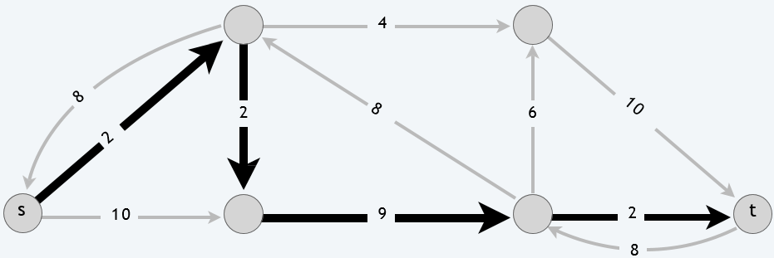
Ford–Fulkerson algorithm demo
network G and flow f
0 / 4
6
10 / 10
2 / 2
8 / 8
6 0 / 6
0 / 10
6
8
10 + 6 = 16
s
0 / 10
2 / 9
10 / 10
t
2nd augmenting path
fixes mistake from previous
(second) augmenting path
residual network Gf
4
6
2
8
6
4
10
s
4
6
1
10
t
8

Slide 44
Ford–Fulkerson algorithm demo
network G and flow f
0 / 4
2
8
10 / 10
0 2 / 2
8 / 8
6 / 6
6 / 10
s
8
t
16 + 2 = 18
6 / 10
8 / 9
10 / 10
fixes mistake from previous
(second) augmenting path
residual network Gf
4
6
2
8
6
4
10
s
4
6
1
10
t
8

Slide 45
Ford–Fulkerson algorithm demo
network G and flow f
0 / 4
2
8
10 / 10
0 2 / 2
8 / 8
6 / 6
6 / 10
s
8
t
16 + 2 = 18
6 / 10
8 / 9
10 / 10
2
residual network Gf
2
8
2
8
6
2
10
s
2
8
1
10
t
8

Slide 46
Ford–Fulkerson algorithm demo
network G and flow f
0 / 4
2
8
10 / 10
0 2 / 2
8 / 8
6 / 6
6 / 10
s
8
t
16 + 2 = 18
6 / 10
8 / 9
10 / 10
2
residual network Gf
2
8
2
8
6
2
10
s
2
8
1
10
t
8

Slide 47
Ford–Fulkerson algorithm demo
network G and flow f
2 / 4
3
7
9
10 / 10
0/ 2
8 / 8
6 / 6
8 / 10
9
9
s
8 / 10
8 / 9
10 / 10
t
18 + 1 = 19
2
residual network Gf
2
8
2
8
6
2
10
s
2
8
1
10
t
8

Slide 48
Ford–Fulkerson algorithm demo
network G and flow f
3 / 4
10 / 10
0/ 2
6 / 6
9 / 10
7 / 8
s
9 / 10
9 / 9
10 / 10
t
18 + 1 = 19
3
residual network Gf
1
9
nodes reachable from s
2
7
6
1
10
1
s
1
9
9
10
t

Slide 49
Ford–Fulkerson algorithm demo
network G and flow f
3 / 4
min cut
10 / 10
0/ 2
6 / 6
value of max flow
7 / 8
9 / 10
s
9 / 10
9 / 9
10 / 10
t
18 + 1 = 19
capacity = 10 + 9 = 19
3
residual network Gf
1
9
nodes reachable from s
2
7
6
1
10
1
s
1
9
9
10
t

Slide 50
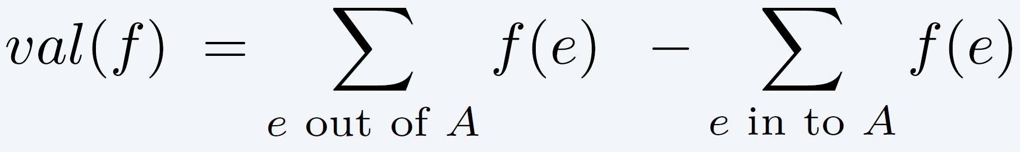
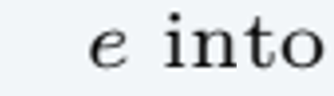
Relationship between flows and cuts
Flow value lemma. Let f be any flow and let (A, B) be any cut. Then, the value of the flow f equals the flow across the cut (A, B).
net flow across cut = 5 + 10 + 10 = 25
5 / 9
10 / 10
0 / 4
5 / 15
0 / 15
5 / 10
s
5 / 5
5 / 8
10 / 10
t
10 / 15
0 / 4
0 / 6
0 / 15
10 / 10
10 / 16
value of flow = 25

Slide 51
Relationship between flows and cuts
Flow value lemma. Let f be any flow and let (A, B) be any cut. Then, the value of the flow f equals the flow across the cut (A, B).
net flow across cut = 10 + 5 + 10 = 25
5 / 9
10 / 10
0 / 4
5 / 15
0 / 15
5 / 10
s
5 / 5
5 / 8
10 / 10
t
10 / 15
0 / 4
0 / 6
0 / 15
10 / 10
10 / 16
value of flow = 25

Slide 52
Relationship between flows and cuts
Flow value lemma. Let f be any flow and let (A, B) be any cut. Then, the value of the flow f equals the flow across the cut (A, B).
net flow across cut = (10 + 10 + 5 + 10 + 0 + 0) – (5 + 5 + 0 + 0) = 25
5 / 9
10 / 10
0 / 4
5 / 15
0 / 15
5 / 10
s
5 / 5
5 / 8
10 / 10
t
10 / 15
0 / 4
0 / 6
0 / 15
10 / 10
10 / 16
value of flow = 25

Slide 53
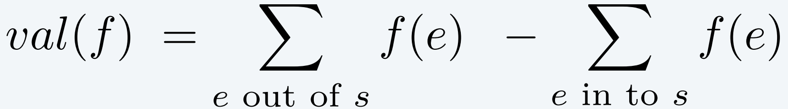
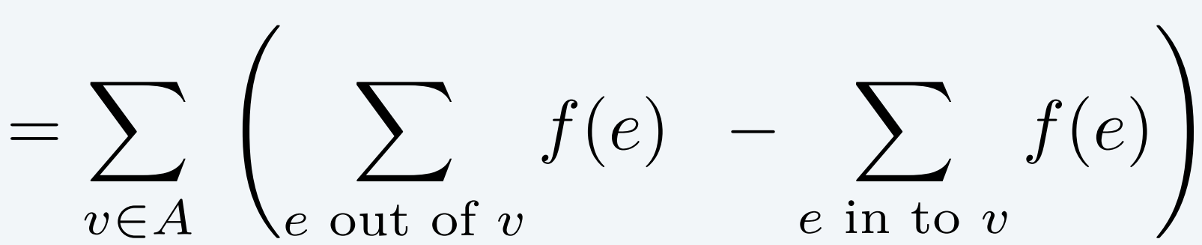
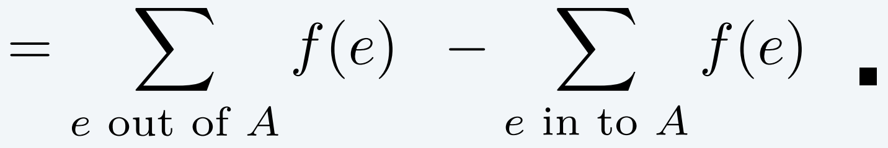
Relationship between flows and cuts
Flow value lemma. Let f be any flow and let (A, B) be any cut. Then, the value of the flow f equals the flow across the cut (A, B).
Pf.
by flow conservation,
all terms except for
v = s are 0, also note:
t ∉ A
net flow across cut = 25
5 / 9
10/10
0 / 4
5 / 15
0/15
5/ 10
s
5/ 5
5/ 8
10 / 10
t
10/ 15
0 / 4
0/ 6
0/ 15
10 / 10
10/16
value of flow = 25
Notes:
ebook-Algorithms Design Techniques Analysis-revised edition-2016-World.Scientific中用数学归纳法来证，似乎更好。

Slide 54
Network flow: quiz
Which is the flow across the given cut?
A. 11 (20 + 25 − 8 − 11 − 9 − 6)
B. 26 (20 + 22 − 8 − 4 − 4)
C. 42 (20 + 22)
D. 45 (20 + 25)
flow
capacity
s
20 / 20
8 / 8
4 / 10
1 / 6
5 / 12
8 / 8
4 / 11
4 / 9
0 / 6
4 / 8
1 / 1
14 / 16
22 / 25
t

Slide 55
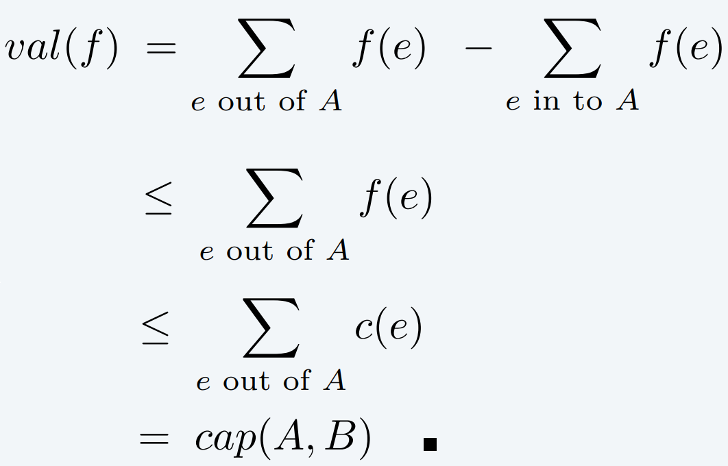
Relationship between flows and cuts
Weak duality. （弱对偶性）
Let f be any flow and (A, B) be any cut. Then, val( f ) ≤ cap(A, B).
Pf.
flow value lemma
8 / 9
10 / 10
0 / 4
2 / 15
0 / 15
8 / 10
10
s
5 / 5
7 / 8
9 / 10
t
s
5
t
12 / 15
0 / 4
2 / 6
0 / 15
10 / 10
15
12 / 16
value of flow = 27
≤
capacity of cut = 30

Slide 56
Certificate of optimality
Weak duality. Let f
be any flow and (A, B) be any cut. Then, val( f ) ≤ cap(A, B).
Corollary. Let f be a flow and let (A, B) be a cut.
If val( f ) = cap(A, B), then f is a max flow and (A, B) is a min cut.
Pf.
weak duality
・For any flow f ':
val( f ') ≤ cap(A, B) = val( f ).
・For any cut (A', B'): cap(A', B') ≥ val( f ) = cap(A, B). ▪
weak duality
8 / 9
10 / 10
0 / 4
2 / 15
0 / 15
8 / 10
10
s
5 / 5
8 / 8
10 / 10
t
s
8
t
13 / 15
0 / 4
3 / 6
0 / 15
10 / 10
10
13 / 16
value of flow = 28
=
capacity of cut = 28

Slide 57
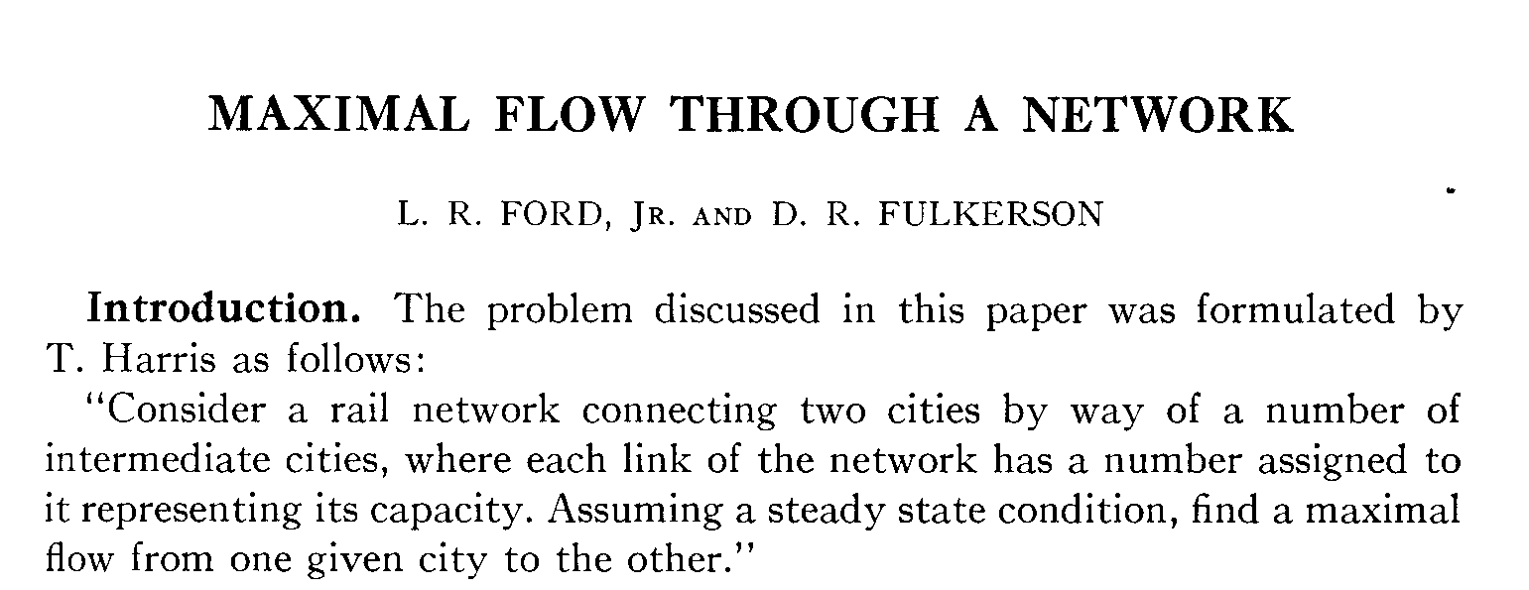
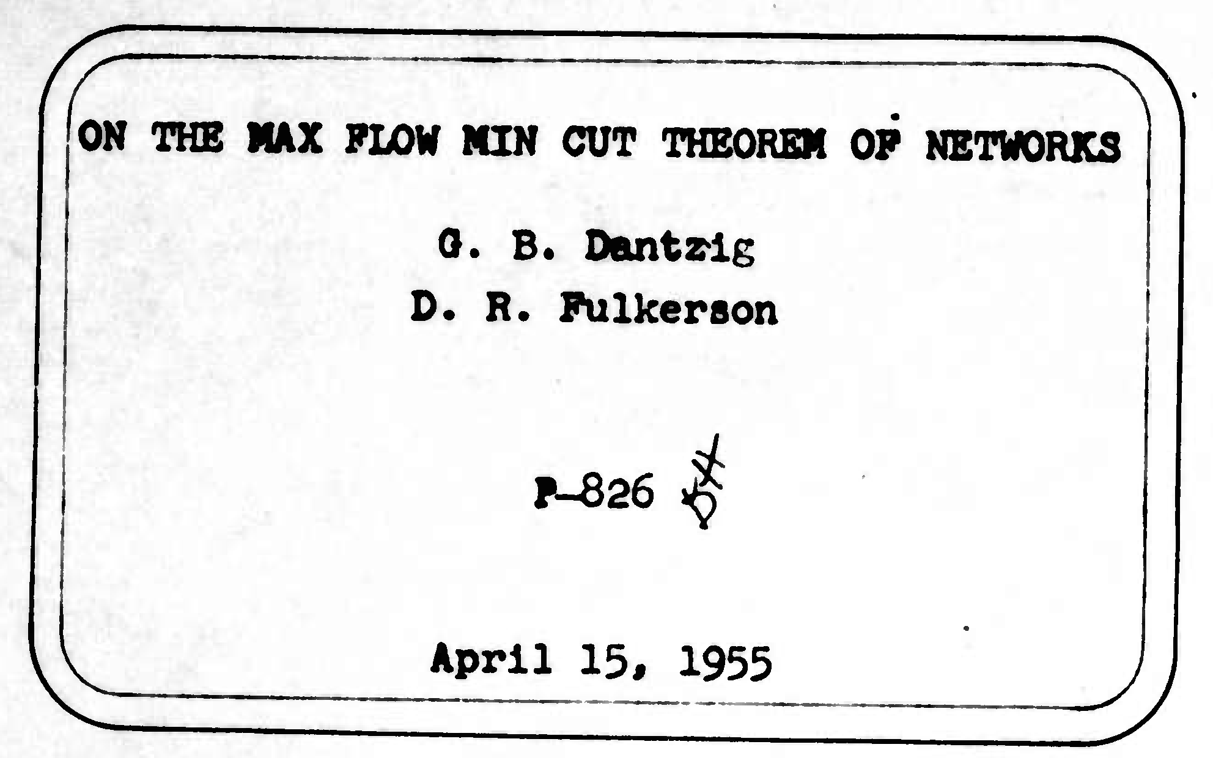
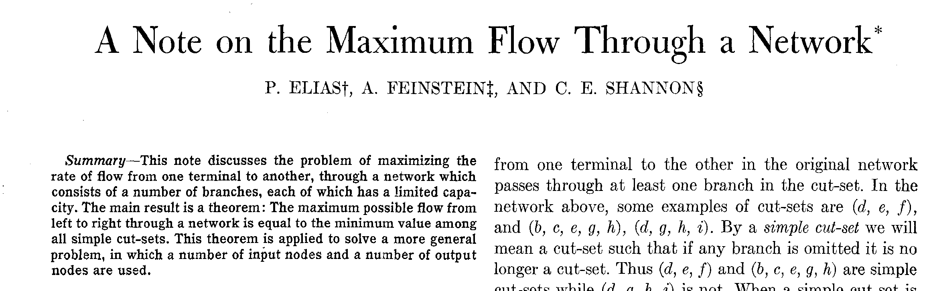
Max-flow min-cut theorem
Max-flow min-cut theorem. Value of a max flow = capacity of a min cut.
strong duality

Slide 58
Max-flow min-cut theorem
Max-flow min-cut theorem. Value of a max flow = capacity of a min cut.
Augmenting path theorem. A flow f is a max flow iff no augmenting paths.
The following three conditions are equivalent for any flow f :
i. There exists a cut (A, B) such that cap(A, B) = val( f ).
ii. f is a max flow.
iii. There is no augmenting path with respect to f .
Pf.
[ i ⇒ ii ]
・This is the weak duality corollary. ▪

Slide 59
Max-flow min-cut theorem
Max-flow min-cut theorem. Value of a max flow = capacity of a min cut.
Augmenting path theorem. A flow f is a max flow iff no augmenting paths.
The following three conditions are equivalent for any flow f :
i. There exists a cut (A, B) such that cap(A, B) = val( f ).
ii. f is a max flow.
iii. There is no augmenting path with respect to f .
if Ford–Fulkerson terminates, then f is max flow
Pf.
[ ii ⇒ iii ] We prove contrapositive: ¬ iii ⇒ ¬ ii.
・Suppose that there is an augmenting path with respect to f .
・Can improve flow f by sending flow along this path.
・Thus, f is not a max flow. ▪

Slide 60
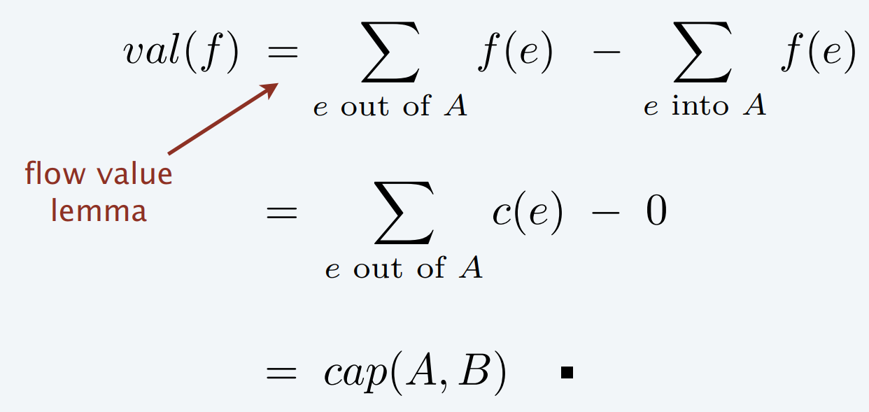

Max-flow min-cut theorem
i. There exists a cut (A, B) such that cap(A, B) = val( f ).
iii. There is no augmenting path with respect to f .
Pf.
[ iii ⇒ i ]
Let f be a flow with no augmenting paths.
Let A be set of nodes reachable from s in residual network Gf .
By definition of A: s ∈ A.
By definition of flow f : t ∉ A.
edge e = (v, w) with v ∈ B, w ∈ A
must have f (e) = 0
original flow network G
A
B
flow value lemma
t
s
edge e = (v, w) with v ∈ A, w ∈ B
must have f (e) = c(e)

Slide 61
More Analysis of Ford–Fulkerson algorithm
Assumption. Every edge capacity c(e) is an integer.
Q: Why integer? What if we have real numbers as capacities?
A:
  The capacities in many practical application of network flow would be integers or rational numbers.
  With pathological choices for the augmenting path, the Ford-Fulkerson Algorithm performs badly.
Pathology. When edge capacities can be irrational, no guarantee
that Ford–Fulkerson terminates (or converges to a
maximum flow)!

Slide 62
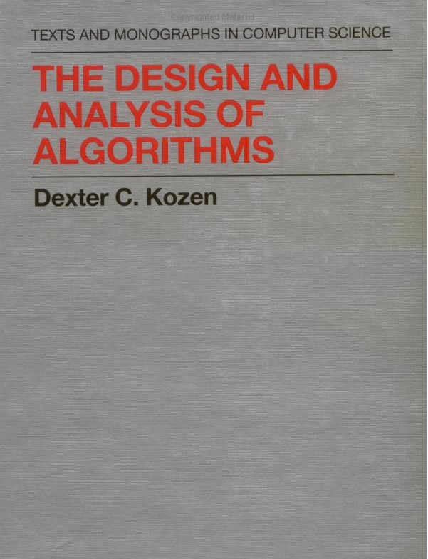
Ford–Fulkerson algorithm: pathological example
from:
SECTION 17.2 – Example 17.2

Slide 63
Analysis of Ford–Fulkerson algorithm (when capacities are integral)
Assumption. Every edge capacity c(e) is an integer between 1 and C.
all the following slides are based on this assumption
Integrality invariant. Throughout Ford–Fulkerson, every edge flow f (e)
and residual capacity c_{f} (e) is an integer.
Pf. By induction on the number of augmenting paths. ▪
Augmenting path theorem. Ford–Fulkerson terminates after at most val( f *)
augmenting paths, where f * is a max flow.
Pf. Each augmentation increases the value of the flow by at least 1. ▪
Integrality theorem. There exists an integral max flow f *.
Pf. Since Ford–Fulkerson terminates, theorem follows from integrality invariant (and augmenting path theorem). ▪
Corollary. The running time of Ford–Fulkerson is O(mnC).
Pf. Can use either BFS or DFS to find an augmenting path in O(m) time. ▪

Slide 64
Application of Max-flow Algorithms: Matching
Def. Given an undirected graph G = (V, E), subset of edges M ⊆ E
is a matching if each node appears in at most one edge in M.
Max matching. Given a graph G, find a max-cardinality matching.

Slide 65
Bipartite matching
Def. A graph G is bipartite if the nodes can be partitioned into two subsets
L and R such that every edge connects a node in L with a node in R.
Bipartite matching. Given a bipartite graph G = (L ∪ R, E), find a max- cardinality matching.
1
1'
2
2'
3
3'
4
4'
L
5
5'
R
matching: 1-1', 2-2', 3-4', 4-5'

Slide 66
Bipartite matching: max-flow formulation
Create digraph G ' = (L ∪ R ∪ {s, t}, E' ).
Direct all edges from L to R, and assign infinite capacity.
Add unit-capacity edges from s to each node in L.
Add unit-capacity edges from each node in R to t.
G′
1
∞
1'
1
2
2'
1
s
3
3'
t
4
4'
5
5'
L
R

Slide 67
Max-flow formulation: proof of correctness
Theorem. Max cardinality of a matching in G = value of max flow in G' .
Pf. ≤
Given a max matching M of cardinality k.
Consider flow f that sends 1 unit on each of the k corresponding paths.
f is a flow of value k. ▪
1
1'
1
∞
1'
1
2
2'
1
2
2'
3
3'
s
3
3'
t
4
4'
4
4'
G
5
5'
5
5'
G′

Slide 68
Max-flow formulation: proof of correctness
Theorem. Max cardinality of a matching in G = value of max flow in G' .
Pf. ≥
Let f be a max flow in G' and let k denote its value.
Integrality theorem ⇒ k is integral and can assume f (e) is 0 or 1.
Consider M = set of edges from L to R with f (e) = 1.
-
-
each node in L and R participates in at most one edge in M, i.e., M is a matching.
|M | = k : apply flow-value lemma to cut (L ∪ {s}, R ∪ {t}) ▪
1
∞
1'
1
1'
1
2
2'
1
2
2'
s
3
3'
t
3
3'
4
4'
4
4'
G′
5
5'
5
5'
G

Slide 69
Network flow II: quiz
What is running time of Ford–Fulkerson algorithms to find a maximum matching in a bipartite graph with |L| = |R| = n?
O(m + n)
O(mn)
O(mn²)
O(m²n)

